Slide 1
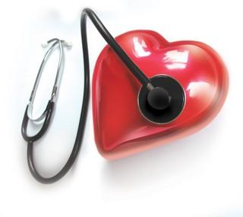
Managing Your
Blood Pressure

Slide 2
What is hypertension?
Hypertension or cardiovascular hypertension is high blood pressure, meaning the blood is putting excess pressure on the blood vessels
It is measured by the pressure the blood is putting on your arteries
If it is abnormally high, it is called hypertension

Slide 3
What causes hypertension?
Obesity
Diabetes or pre-diabetes
High salt diet
Frequent moderate alcohol consumption
Lack of exercise
High stress levels
Mineral deficiencies

Slide 4
What causes hypertension?
Plaques in arteries
Inflammation
Eating a diet high in processed foods
Medications (NSAIDS, steroids, birth control)
Sleep apnea

Slide 5
Real causes of hypertension
The previous slide showed the conditions linked to hypertension
But most of those don't cause hypertension
They are merely present along with hypertension
A few that really do cause hypertension are:
  Stress
  Poor diet (salt, processed foods, mineral deficient)
  Lack of exercise
  Frequent alcohol consumption
  Low estrogen levels in women (e.g. post-menopause)

Slide 6
Related blood tests
Heart panel tests like CRP and homocysteine
Nutrient tests for minerals
Hormone tests for cortisol (and estrogen for women)

Slide 7
Dietary changes
Cut out processed, packaged and restaurant foods
No added salt to foods
Cook with garlic
Eat lots of vegetables (mineral rich)
Cook with coconut oil
Use extra virgin olive oil raw on salads
Drink sufficient water
Electrolytes
Juicing - especially nitrates from beets

Slide 8
Lifestyle changes
Relaxation techniques
  Meditation
  Breathing
  Yoga
  Tai-chi
Exercise
Laughter
Quit smoking

Slide 9
Lifestyle changes
Acupuncture
Aromatherapy
Love

Slide 10
Supplements
Garlic
Whole food sourced minerals
Omega-3 fish oil
B complex vitamins
Vitamin C

